Slide 1

WHICH IS THE BEST COUNTRY?
Criteria
What is unique
Temperature of the sea
How can you go from A to B

Slide 2

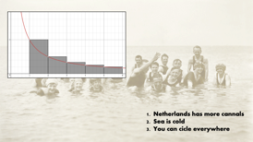
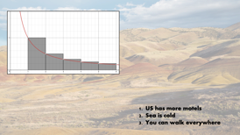
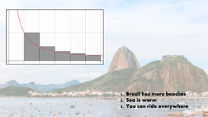

Slide 3

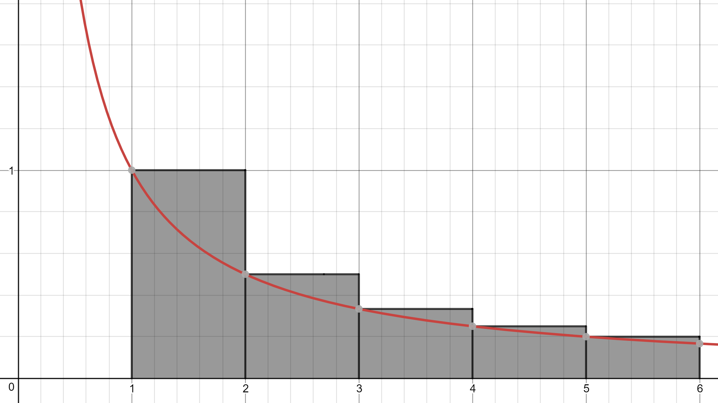
Netherlands has more cannals
Sea is cold
You can cicle everywhere

Slide 4

US has more motels
Sea is cold
You can walk everywhere

Slide 5

Brazil has more beaches
Sea is warm
You can ride everywhere

Slide 6
US has more motels
Sea is cold
You can walk everywhere

